Slide 1


Noida Institute of Engineering and Technology, Greater Noida
PROBLEM REDUCTION
Unit: 02
Introduction to Search
B Tech 3rd Sem
Alka Singh
CSE(AIML)

Slide 2
PROBLEM REDUCTION:
So far we have considered search strategies for OR graphs through which we want to find a single path to a goal.
Such structure represent the fact that we know how to get from a node to a goal state if we can discover how to get from that node to a goal state along any one of the branches leaving it.

Slide 3
AND-OR GRAPHS (AO*)
The AND-OR GRAPH (or tree) is useful for representing the solution of problems that can solved by decomposing them into a set of smaller problems, all of which must then be solved.
This decomposition, or reduction, generates arcs that we call AND arcs. One AND arc may point to any number of successor nodes, all of which must be solved in order for the arc to point to a solution.

Slide 4
AND-OR GRAPHS
Just as in an OR graph, several arcs may emerge from a single node, indicating a variety of ways in which the original problem might be solved.
This is why the structure is called not simply an AND-graph but rather an AND-OR graph (which also happens to be an AND-OR tree)

Slide 5
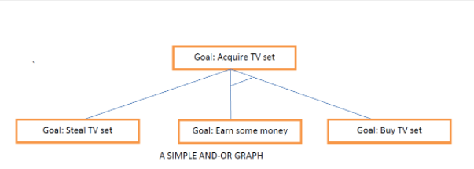
EXAMPLE FOR AND-OR GRAPH

Slide 6
Problem Reduction algorithm
Initialize the graph to the starting node.
2. Loop until the starting node is labelled SOLVED or until its cost goes above FUTILITY:
(i) Traverse the graph, starting at the initial node and following the current best path and accumulate the set of nodes that are on that path and have not yet been expanded.

Slide 7
Problem Reduction algorithm
(ii) Pick one of these unexpanded nodes and expand it. If there are no successors, assign FUTILITY as the value of this node. Otherwise, add its successors to the graph and for each of them compute f'(n). If f'(n) of any node is 0, mark that node as SOLVED.
(iii) Change the f'(n) estimate of the newly expanded node to reflect the new information provided by its successors. Propagate this change backwards through the graph. If any node contains a successor arc whose descendants are all solved, label the node itself as SOLVED.

Slide 8
Constraint Satisfaction Model (CSP)
A problem that requires its solution within some limitation/conditions also known as constraints.
CSP consists of three component (V,D,C)
A finite set of variables which stores the solution.
V = {V1,V2,V3……….Vn}
A set of discrete values known as Domain from which solution is picked
D = {D1,D2,D3………Dn}

Slide 9
Constraint Satisfaction Model (CSP)
A finite set of constraints that specify allowable combination of values.
C = {C1,C2,C3………..Cn}
C_{i} = (scope, rel)
where scope is set of variables that participate in constraint
and rel is relation that defines the value that variable can take.
All the set are finite except domain set.

Slide 10
Constraint Satisfaction Model (CSP)
Some Real world CSP
Timetable Problem
Hardware Configuration
Transportation Scheduling
Factory Scheduling etc

